Slide 1

Code Dojo
21/05/2025

Slide 2
Objectives
Learn more about AI Augmented Development and GitHub Copilot
Know how to configure GH Copilot in your IDE
Learn how to use the GH Copilot:
Chat / Edit / Agent mode
Inline edits
Slash commands
Set context for your prompt
Add custom instructions to your repo

Slide 3
Instructions
Go to https://github.com/features/copilot
Sign up and create a new GitHub account
https://docs.github.com/en/copilot/setting-up-github-copilot/setting-up-github-copilot-for-yourself
VS Code:
Install VS Code (1.100.2): https://code.visualstudio.com/Download
Configure GH Copilot: https://code.visualstudio.com/docs/copilot/setup#_set-up-copilot-in-vs-code
Intellij:
Install Intellij (Community edition – 2025.1.1.1): https://www.jetbrains.com/idea/download/?section=windows
Configure GH Copilot: https://docs.github.com/en/copilot/managing-copilot/configure-personal-settings/installing-the-github-copilot-extension-in-your-environment?tool=jetbrains

Slide 4
What is AI Augmented Development
Reading material (Medium)
AI-Augmented Development is a term that describes the use of AI technologies to assist software developers in creating applications more efficiently, quickly, and reliably. AI-Augmented Development can automate some of the repetitive or tedious tasks in software development, such as code generation, testing, debugging, and documentation. It can also help developers to learn from existing code, find relevant resources, and collaborate with other developers. AI-Augmented Development is considered one of the strategic technology trends for 2024.

Slide 5
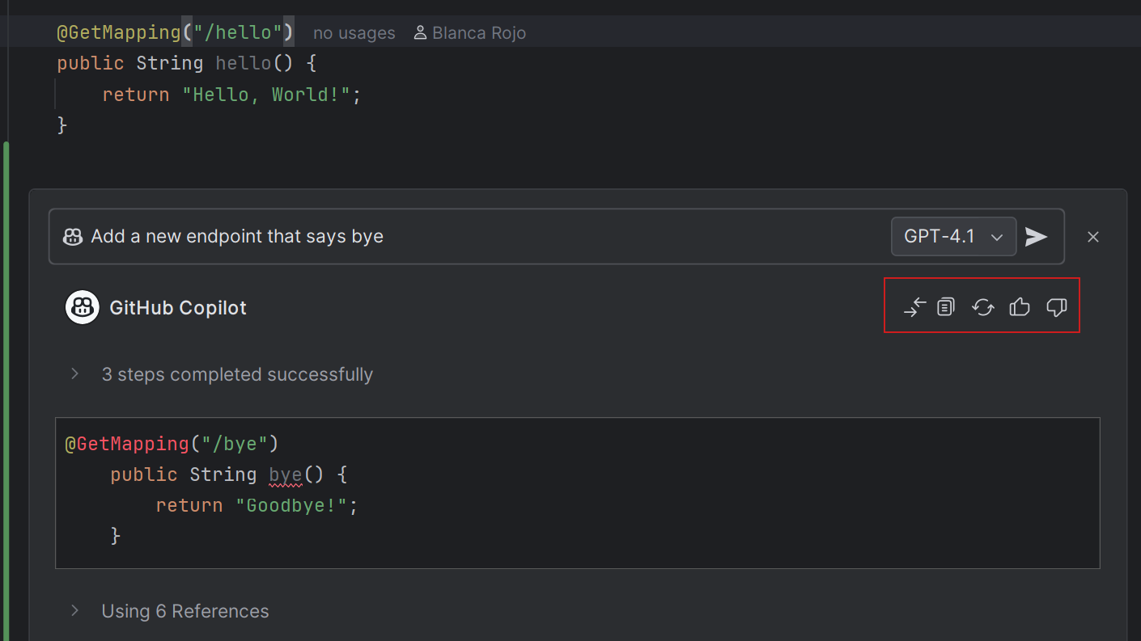
How does GitHub Copilot work
Reading material (GitHub)
Chat - 3 modes (more details here):
Ask mode: The quick gut check
Edit mode: You’re still in charge, just moving faster
Agent mode: A lot of power, when you’re ready for it
Inline questions:

Slide 6
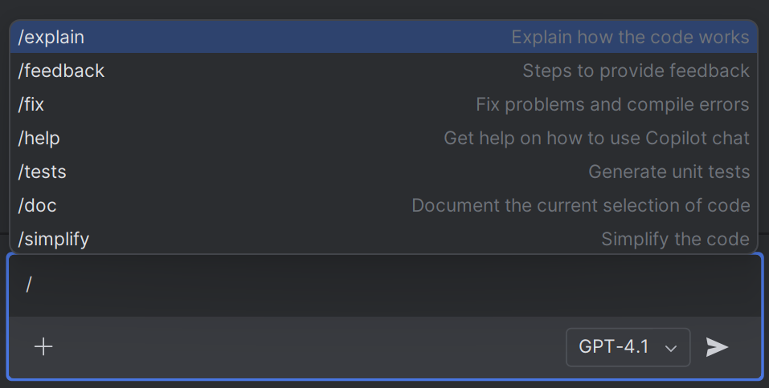
Slash commands
Slash commands (Microsoft)
You can add your own ones

Slide 7
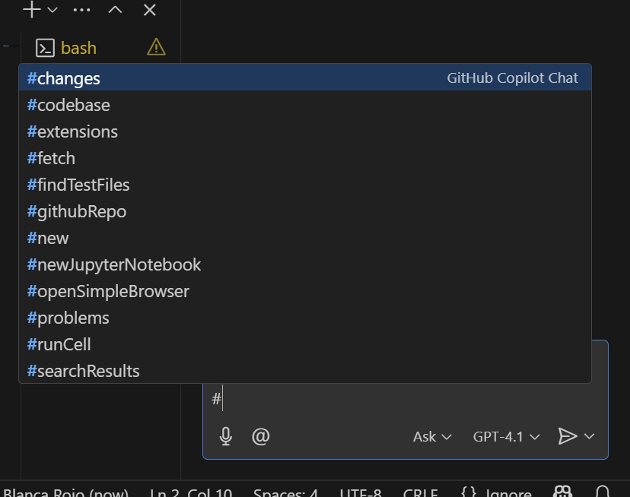
Context
Add context to your prompt (VSCode)

Slide 8
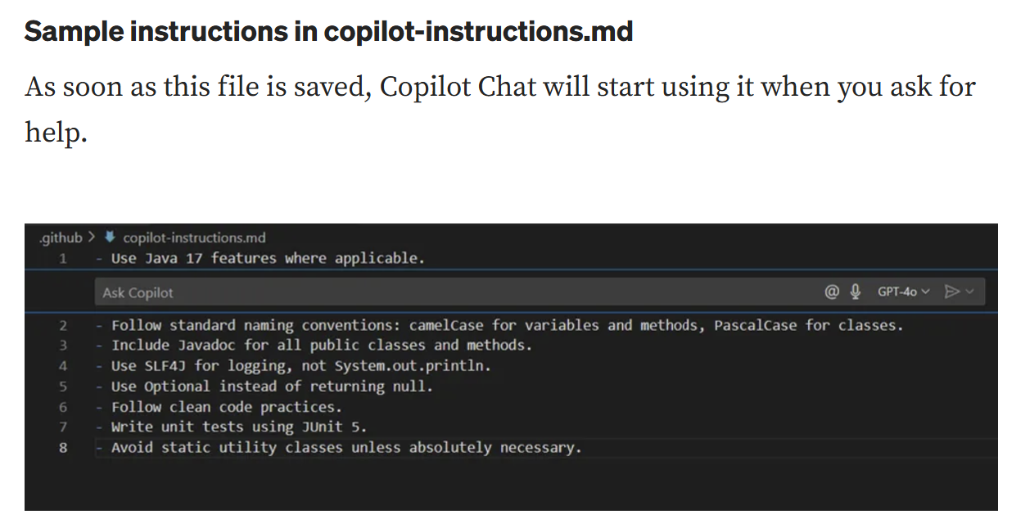
Custom instructions
Add custom instructions (GitHub)
Mastering custom instructions (Medium)

Slide 9
Starter code
Java: https://github.com/blarojo/java-github-copilot
Python: https://github.com/blarojo/python-github-copilot
Exercise:
Clone / download code in your machine
Try inline recommendations, chat, edit mode, agent mode (?)
Add a new endpoint to the existing code using the GH copilot suggestions

Slide 10
Coding exercise – Supermarket Checkout
Business requirements
Design and implement supermarket checkout component with readable API that lets you add an item and calculates the total price of the items added to the basket
Checkout app is stateful, it should store the basket in the DB (Python) or a collection (Java)
App should have unit tests and code should be clean
Stretch goal:
Our goods are priced individually. In addition, there is a concept of promotion - if you buy specific amount of the product, the price will be lower. Example:
Item | Price for one | Offer
Apple | 1£ | 3 for 2£
Bananas | 2£ | 4 for 6£

